Slide 1

HR Analytics Dashboard
Workforce, Retention, Performance & Strategic Insights
A management-ready story built from the Power BI HR dashboard
311 employees • 207 active • 104 terminations
Notes:
[Sources]
Visual on this slide was generated with Microsoft Copilot.
Dashboard metrics: <File>new hr retention dashboard.pdf</File>, page 1.
[/Sources]

Slide 2
Executive summary
The dashboard points to a stable core workforce, but retention and talent risk require focused action.
TOTAL EMPLOYEES
ACTIVE WORKFORCE
TERMINATIONS
AVG. SALARY
AVG. TENURE
311
207
104
$69.02K
13.20
Full employee population
66.56% of workforce
Historical exits
Annual average
Dashboard tenure measure
What stands out
Key risks
Management priorities
Retention is 66.6%, leaving roughly one-third of the historical workforce terminated.
Production is the dominant workforce and payroll population, making it the highest-leverage area for HR action.
90.03% of employees are on track, while 9.97% are low performers.
High-performer share is only 11.9%, so retaining strong talent matters disproportionately.
Production retention is 60.3%, lower than several other major departments.
Exit reasons are spread across job moves, dissatisfaction, pay, career change and hours, suggesting multiple retention levers.
Prioritize Production retention and frontline manager interventions.
Protect high performers through targeted career and compensation reviews.
Use recruitment-source retention, not hire volume alone, to guide sourcing investment.
Notes:
[Sources]
All metrics and insights are derived from <File>new hr retention dashboard.pdf</File>, pages 1, 3, 4, 5, 7, and 8.
[/Sources]

Slide 3
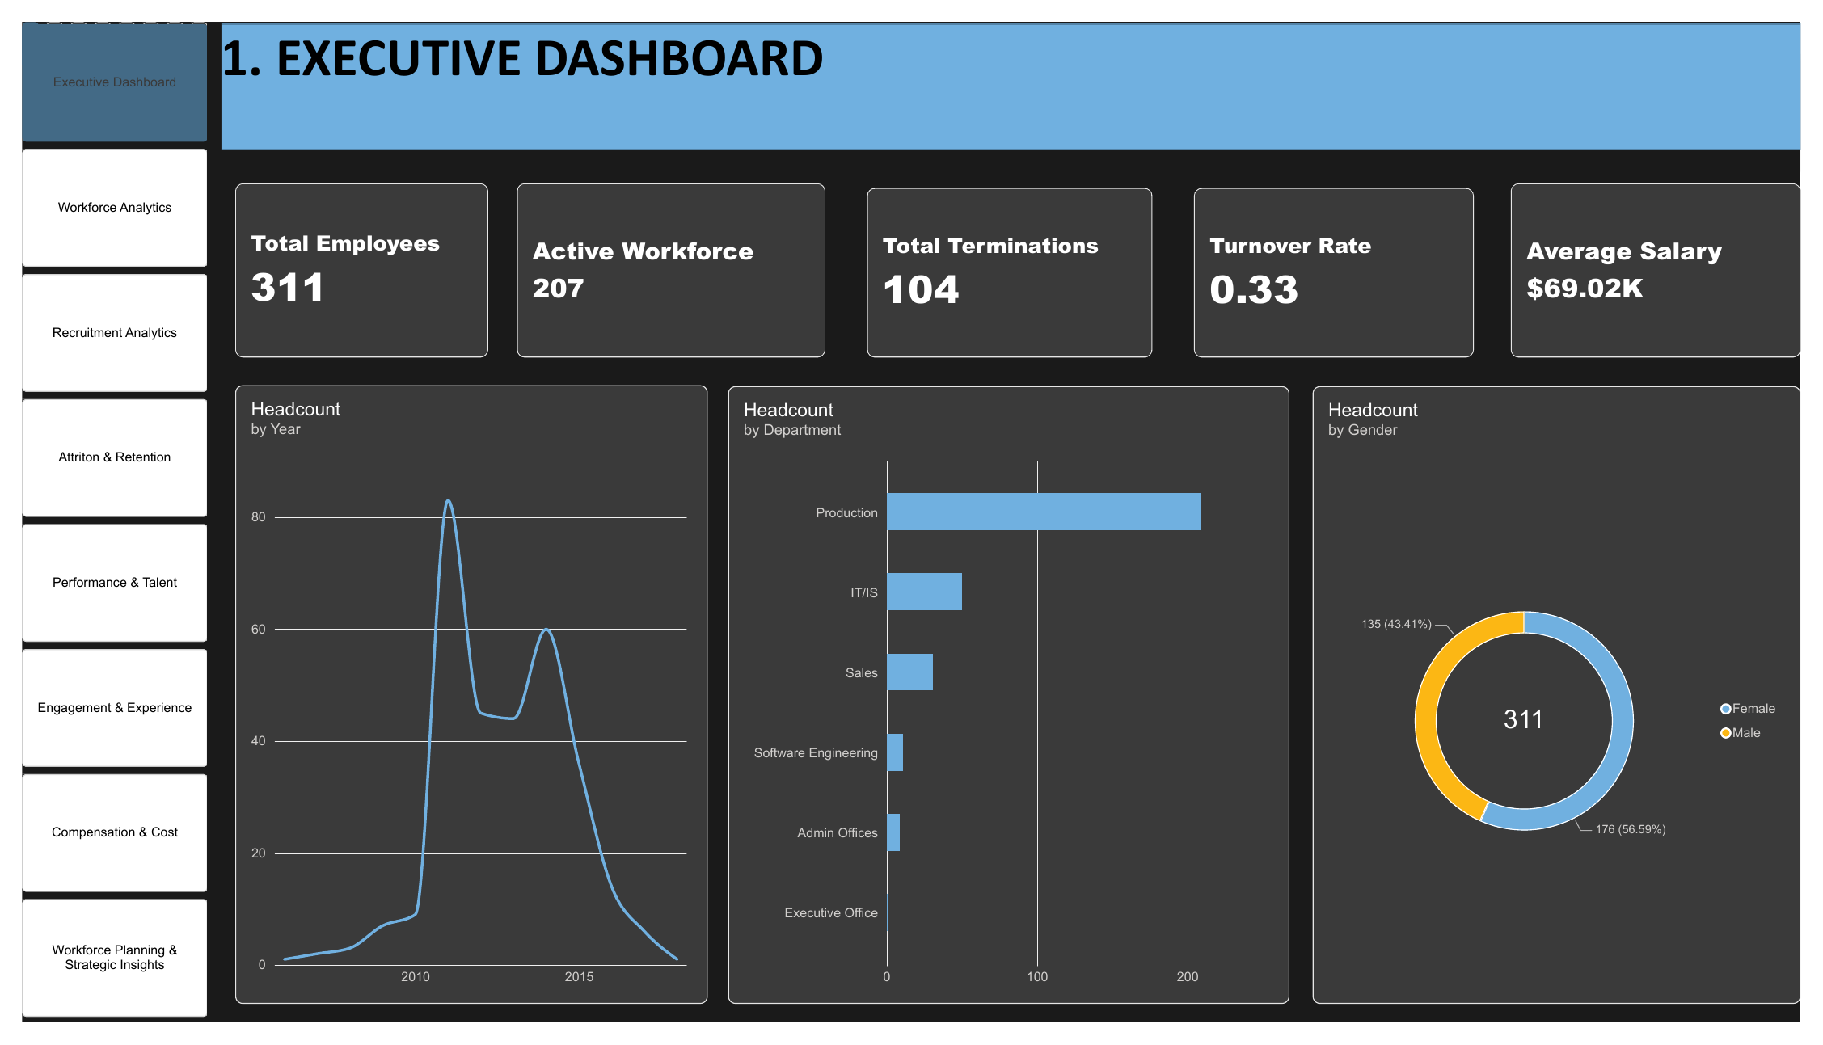
1. Executive workforce overview
A concise view of workforce size, composition, department concentration and salary.
Headline
207 of 311 employees are active, equivalent to 66.6% of the employee population.
Average annual salary is $69.02K.
Interpretation
Production is visibly the largest department, so organization-wide workforce trends will be strongly influenced by Production.
The gender split is 176 vs 135 employees (56.59% vs 43.41%).
Use department slicers when interpreting overall retention, performance and compensation KPIs.
Notes:
[Sources]
Dashboard screenshot and metrics: <File>new hr retention dashboard.pdf</File>, page 1.
[/Sources]

Slide 4
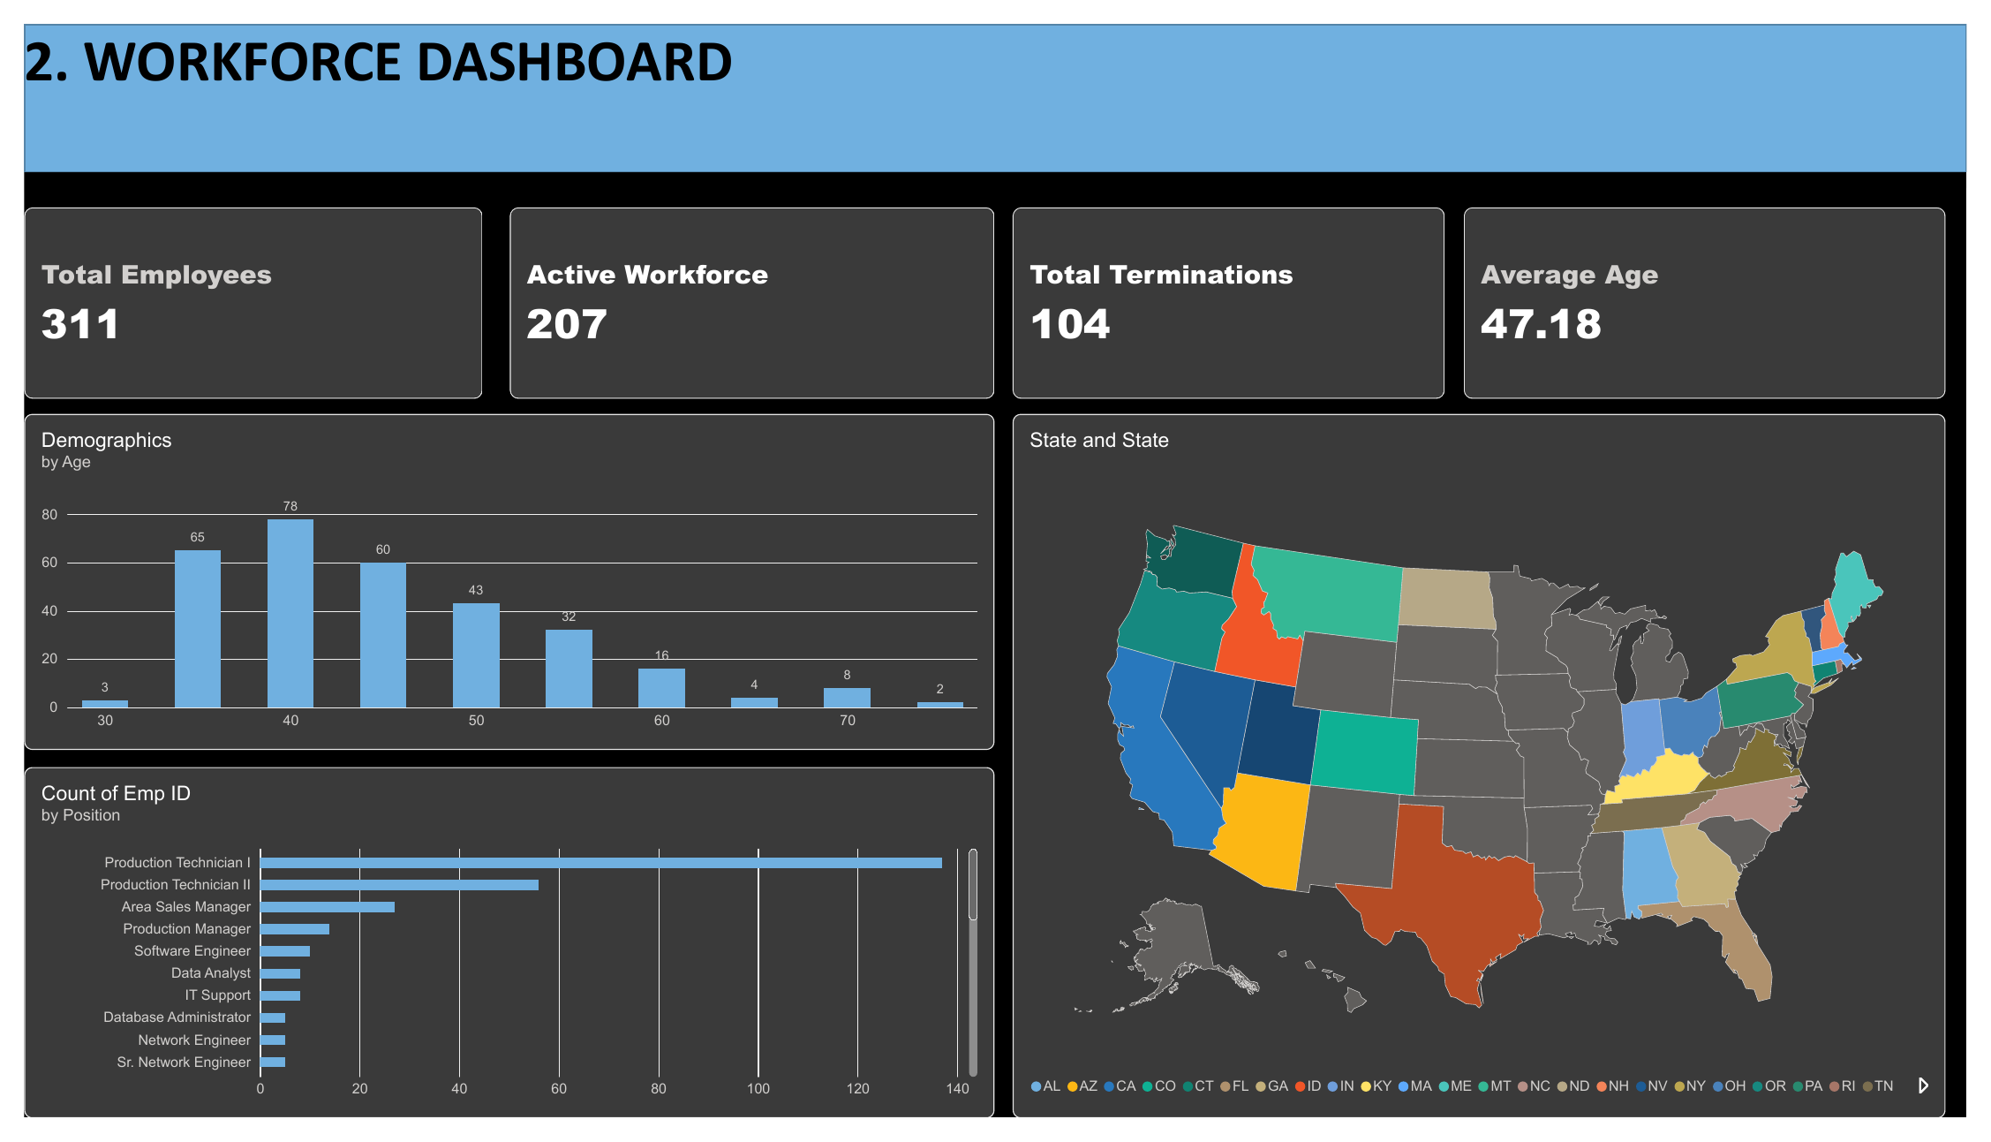
2. Workforce demographics & role structure
The workforce is concentrated in operational roles, with a broad age and geographic footprint.
Workforce profile
Average age is 47.18 years.
Production Technician I is the most prominent position by employee count.
Strategic implication
Role concentration creates succession and capacity risk if hiring or retention weakens in key operational jobs.
Age distribution and the dashboard's retirement-risk signal should be reviewed together for workforce continuity.
Geographic dispersion supports adding location-level workforce planning and recruiting views.
Notes:
[Sources]
Dashboard screenshot and metrics: <File>new hr retention dashboard.pdf</File>, page 2.
[/Sources]

Slide 5
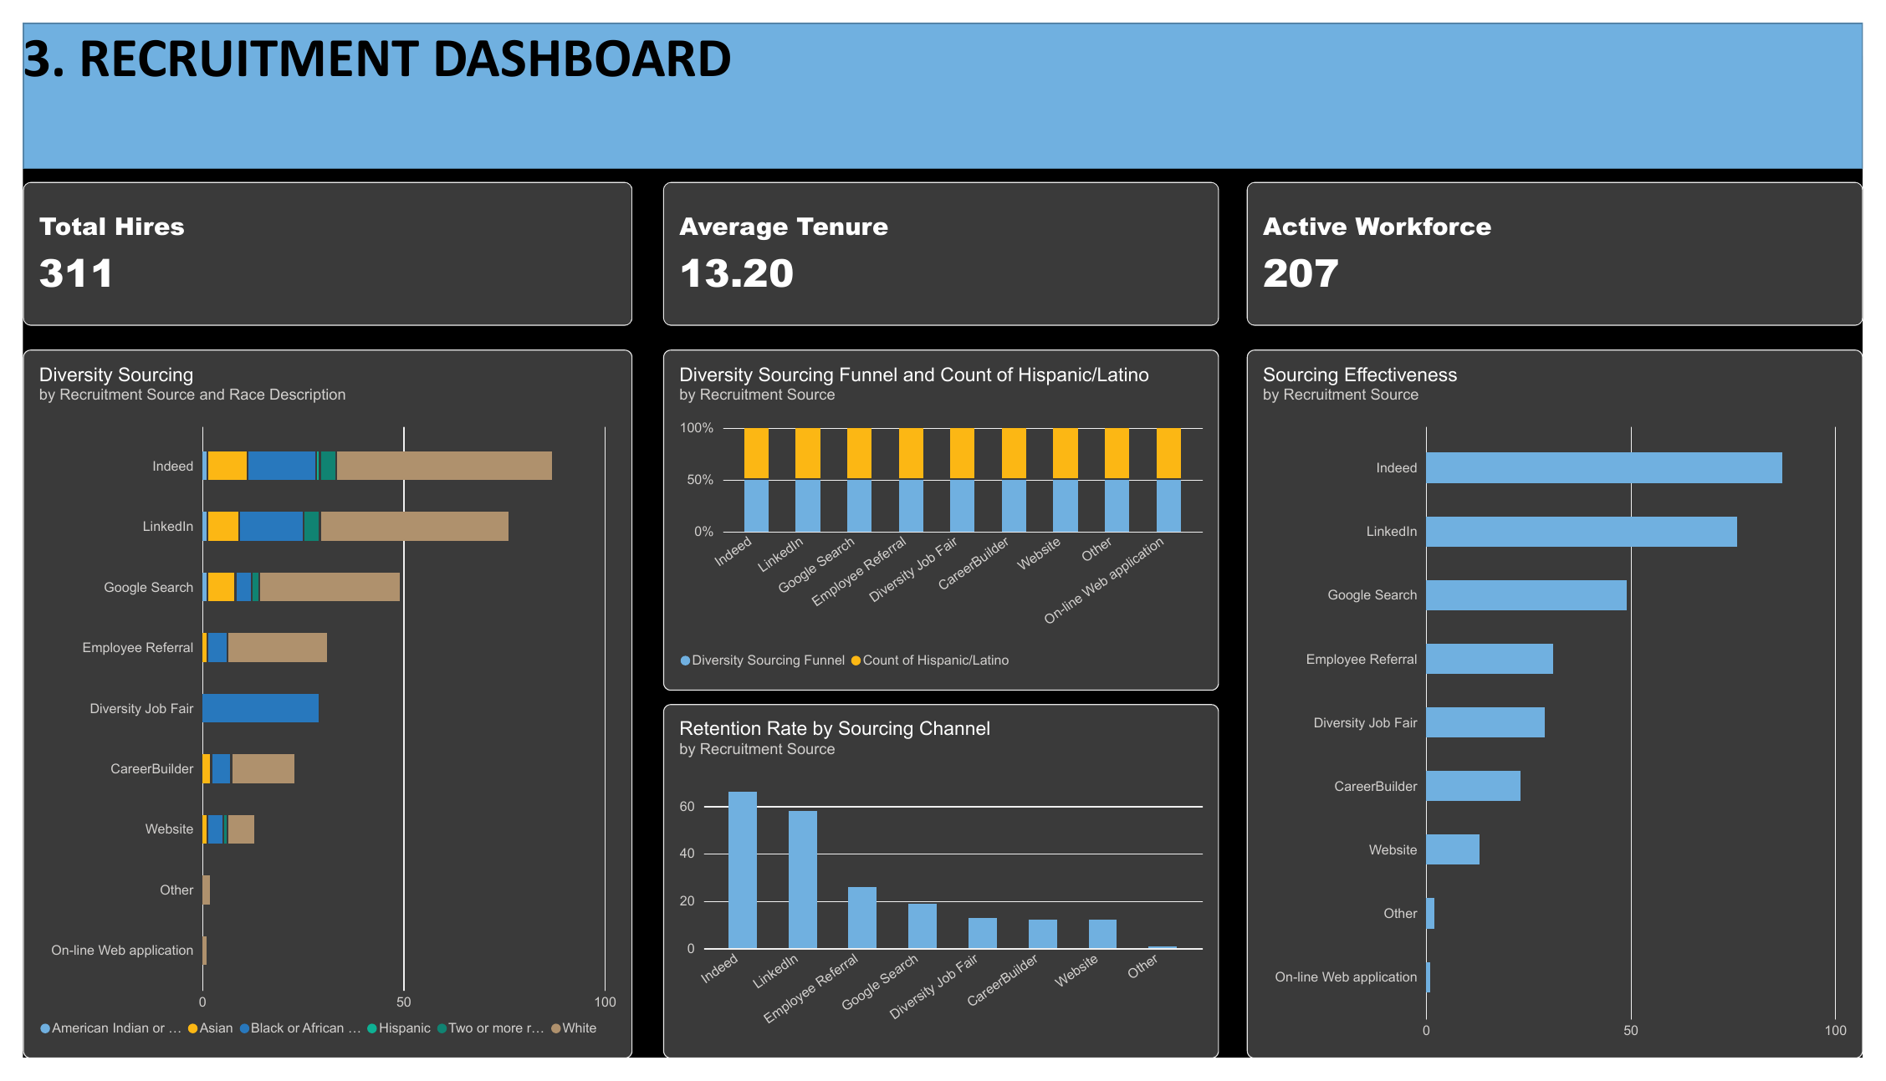
3. Recruitment effectiveness
Hiring volume is only half the story; sourcing quality should be judged by diversity and retention outcomes.
What the page shows
Indeed and LinkedIn appear among the largest recruitment sources.
The dashboard compares sourcing volume, diversity sourcing and retention by channel.
Recommended decision use
Shift sourcing spend toward channels that combine adequate hiring volume with stronger retention.
Track source-of-hire performance by department and role because a channel may work well for one talent segment and poorly for another.
Add time-to-hire and cost-per-hire when those fields become available to complete the recruiting ROI view.
Notes:
[Sources]
Dashboard screenshot and metrics: <File>new hr retention dashboard.pdf</File>, page 3.
[/Sources]

Slide 6
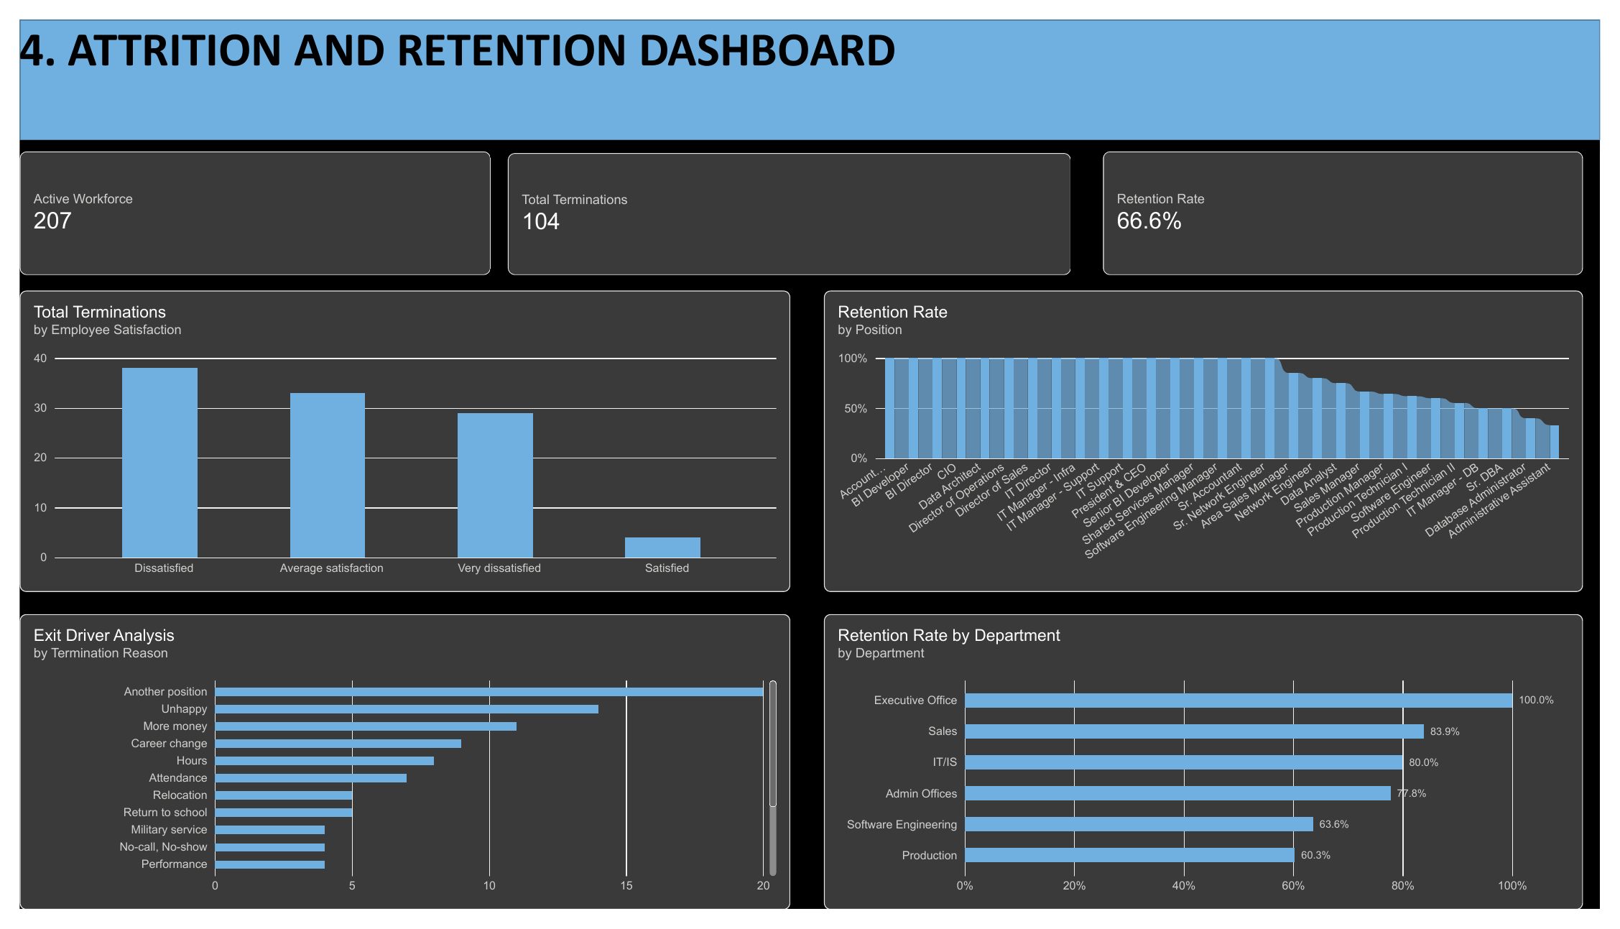
4. Attrition & retention
Overall retention is 66.6%, but the departmental pattern reveals where intervention should start.
Department signal
Executive Office: 100.0% retention.
Sales: 83.9%; IT/IS: 80.0%; Admin Offices: 77.8%.
Software Engineering: 63.6%; Production: 60.3%.
Retention actions
Start root-cause reviews in Production and Software Engineering.
Exit drivers include another position, unhappiness, more money, career change and hours, indicating both external pull and internal experience factors.
Pair exit reasons with manager, tenure and performance to find preventable high-value attrition.
Notes:
[Sources]
Dashboard screenshot and metrics: <File>new hr retention dashboard.pdf</File>, page 4.
[/Sources]

Slide 7
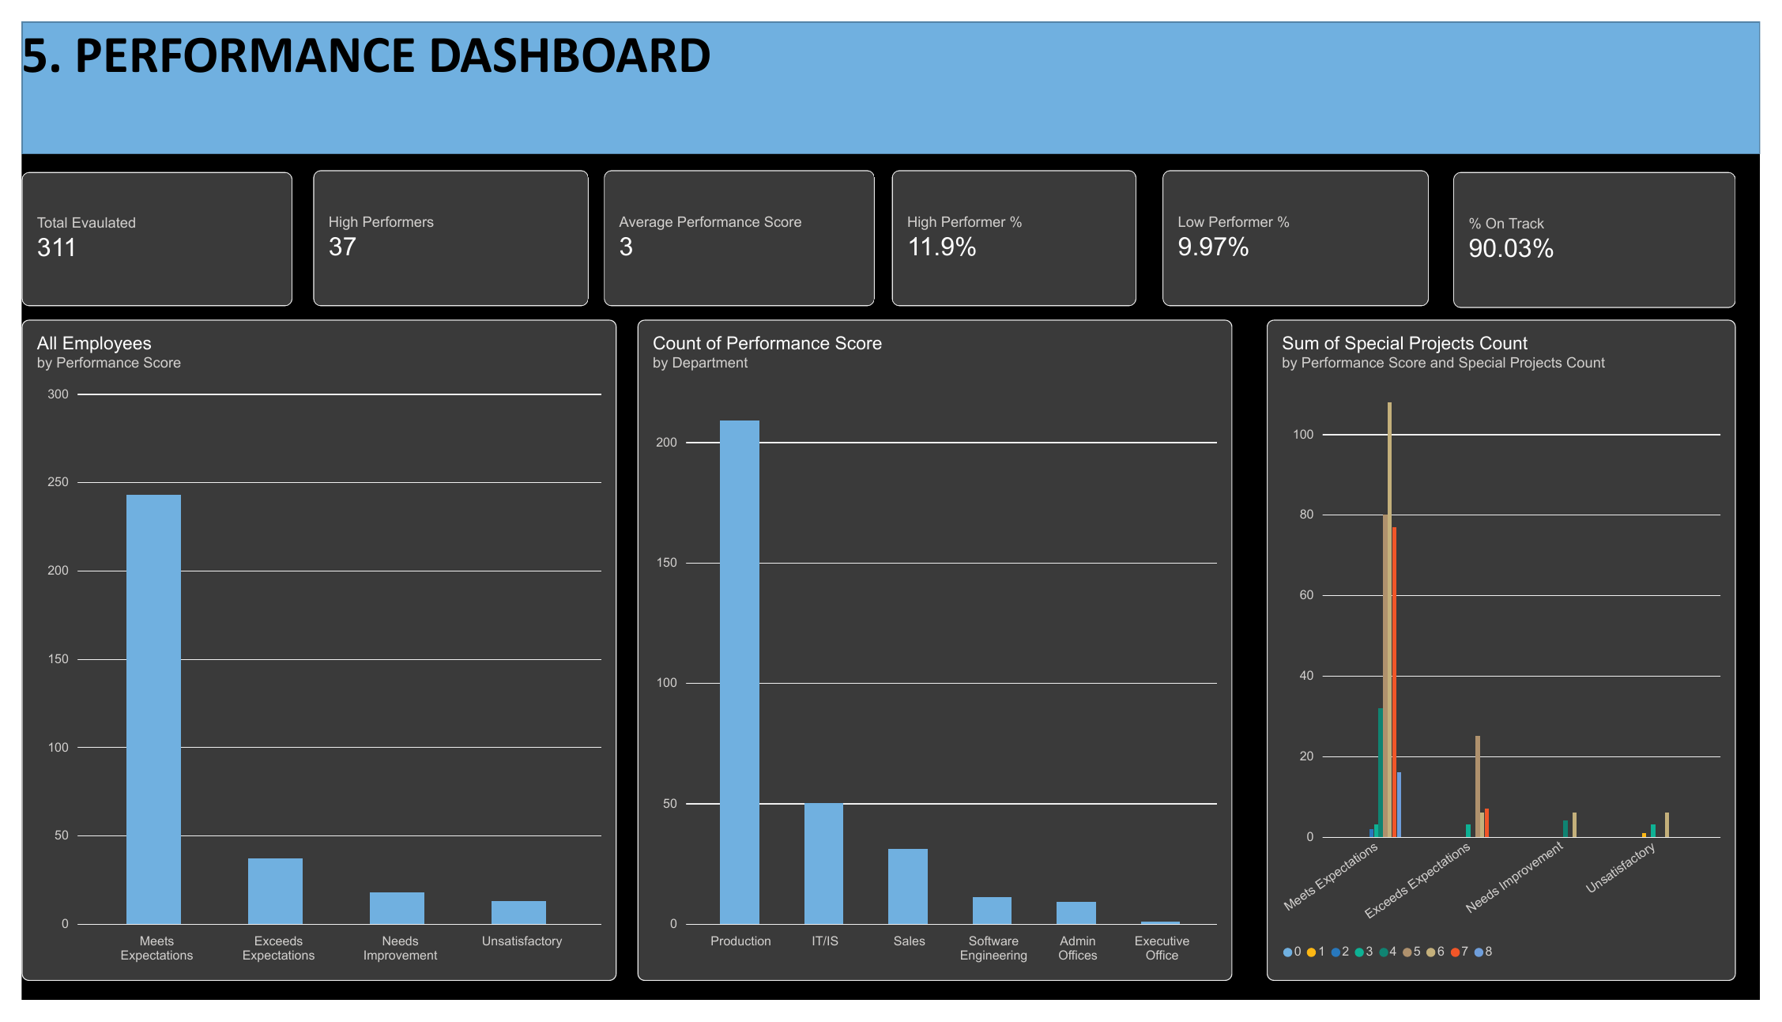
5. Performance & talent
Most employees are meeting expectations, while the high-performer pool is relatively small and strategically important.
HIGH PERFORMERS
% ON TRACK
37
90.03%
HIGH PERF. %
LOW PERF. %
11.9%
9.97%
Talent implication
Retention plans should explicitly identify and protect the 37 high performers.
The low-performer segment is small enough for targeted coaching, role fit reviews and clear performance plans.
Department-level performance should be interpreted alongside headcount to avoid overreacting to small teams.
Notes:
[Sources]
Dashboard screenshot and metrics: <File>new hr retention dashboard.pdf</File>, page 5.
[/Sources]

Slide 8
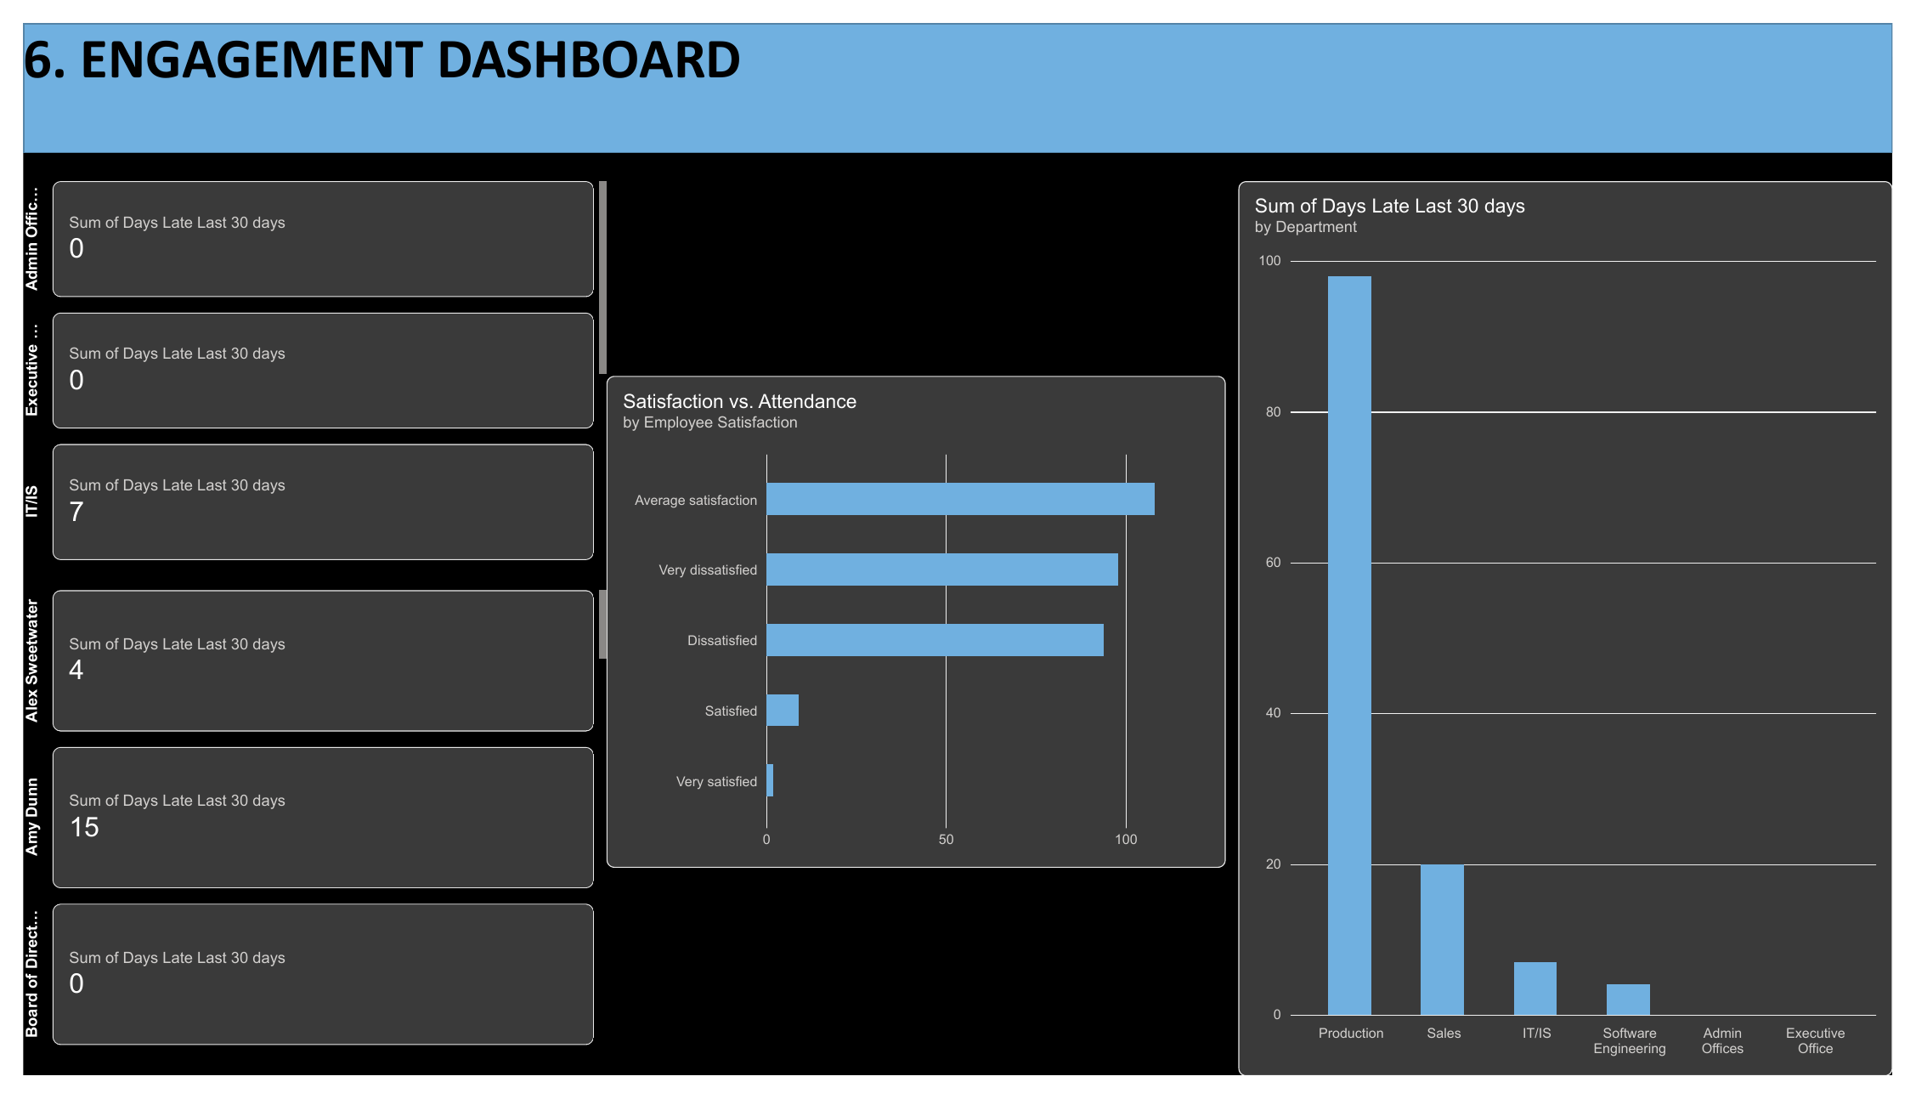
6. Engagement & attendance
Attendance patterns provide a practical early-warning signal when combined with employee satisfaction.
Observed signal
Production records the largest sum of days late in the last 30 days on this page.
The visual links employee satisfaction categories with attendance behavior.
How to use it
Treat repeated lateness as a diagnostic signal, not a conclusion about engagement.
Review satisfaction, lateness, manager and termination outcomes together to identify teams needing support.
For management reporting, normalize attendance by headcount because larger departments naturally accumulate more late days.
Notes:
[Sources]
Dashboard screenshot and metrics: <File>new hr retention dashboard.pdf</File>, page 6.
[/Sources]

Slide 9
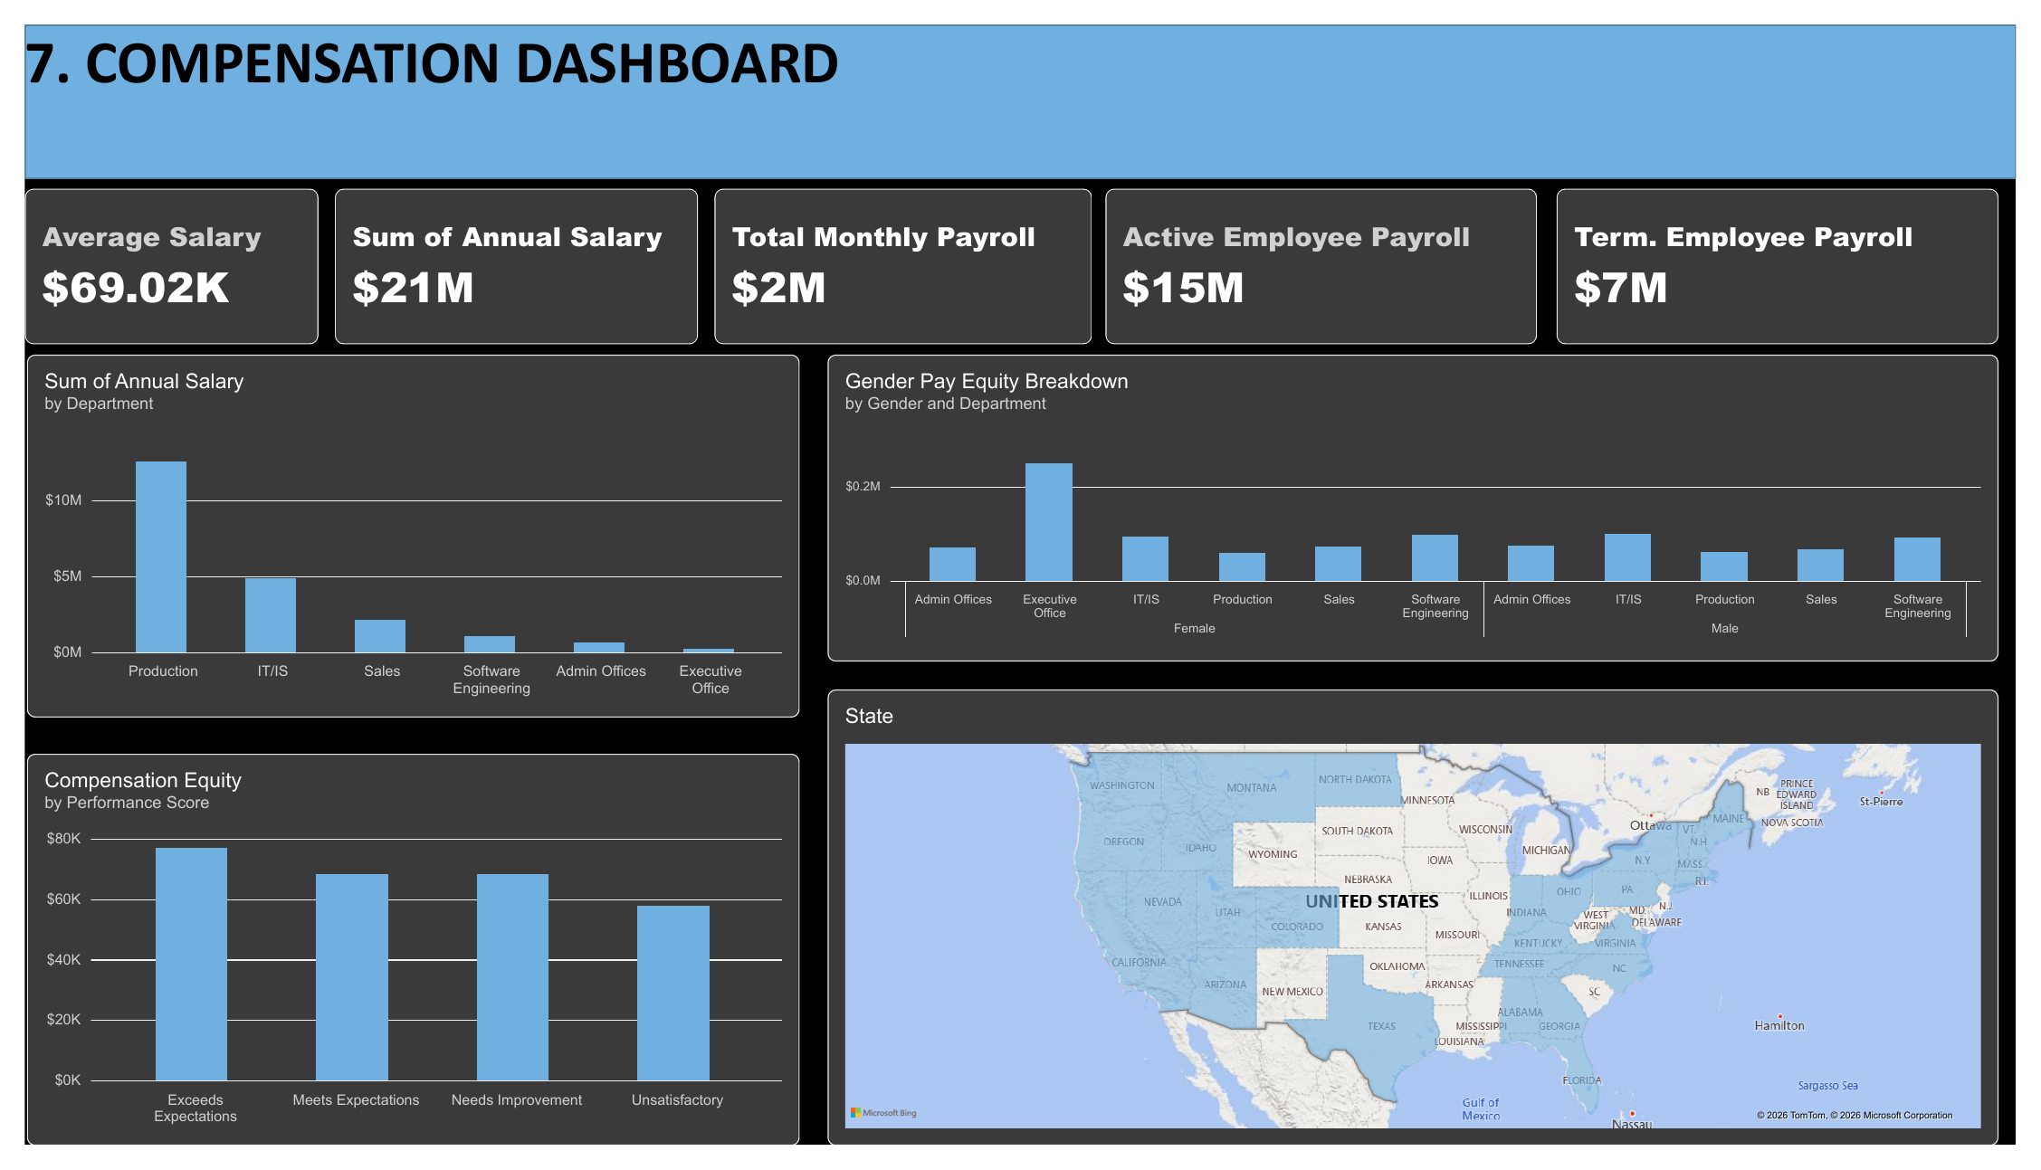
7. Compensation & workforce cost
Annual payroll is approximately $21M, with $15M tied to active employees.
AVG. SALARY
ANNUAL PAYROLL
$69.02K
$21M
ACTIVE PAYROLL
TERM. PAYROLL
$15M
$7M
Compensation insight
Production carries the largest payroll because it has the largest workforce footprint.
Pay by performance score is broadly clustered, so performance differentiation should be monitored alongside job level and role mix.
Gender pay views should be interpreted within comparable roles and departments before drawing equity conclusions.
Notes:
[Sources]
Dashboard screenshot and metrics: <File>new hr retention dashboard.pdf</File>, page 7.
[/Sources]

Slide 10
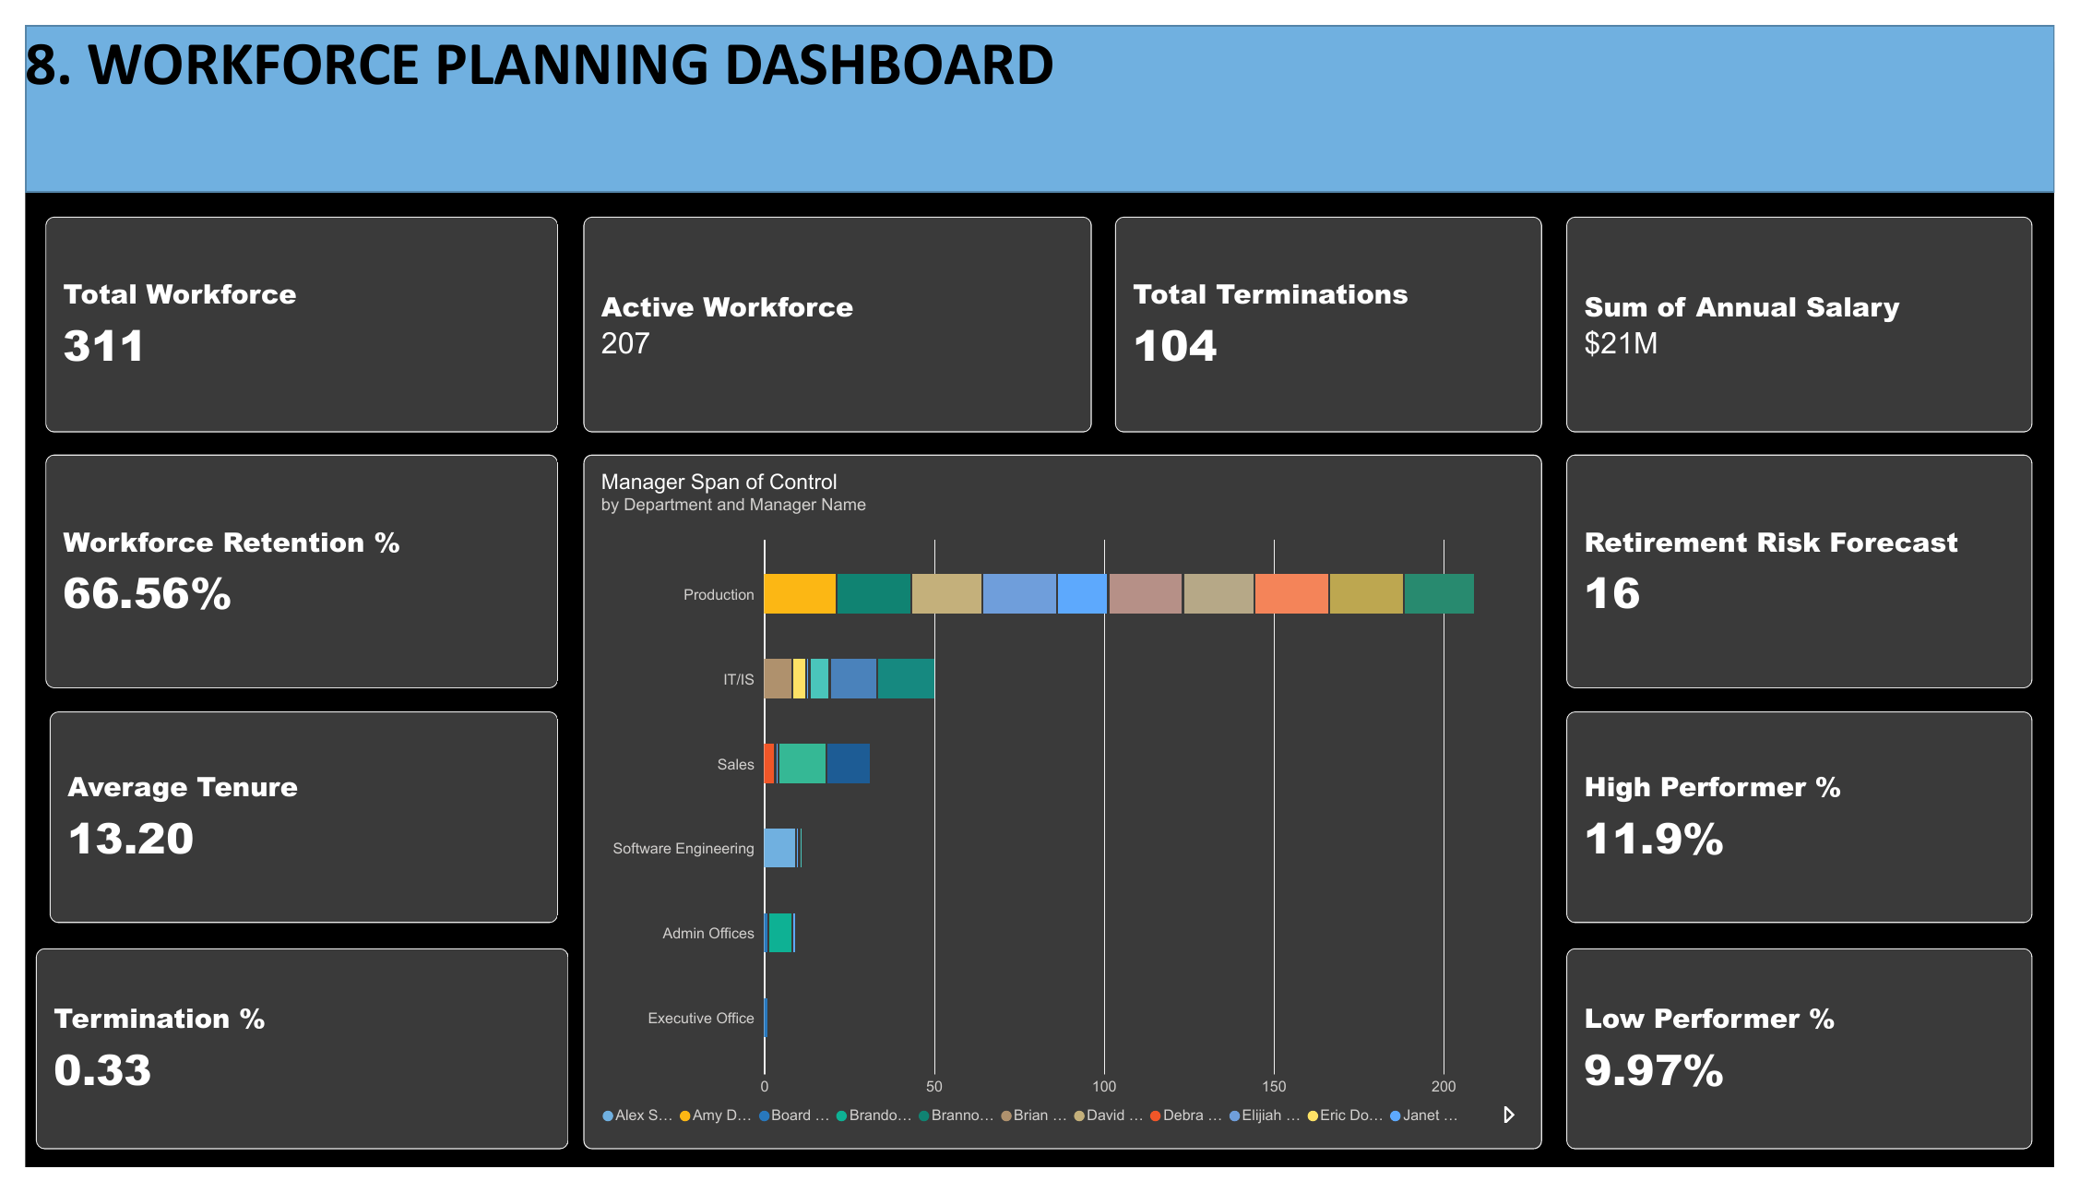
8. Workforce planning & strategic insights
The planning view combines capacity, retention, talent quality and succession risk.
RETENTION
RETIREMENT RISK
66.56%
16
HIGH PERF. %
LOW PERF. %
11.9%
9.97%
Planning priorities
Prepare succession or knowledge-transfer plans for the 16 employees flagged in the retirement-risk forecast.
Review manager span of control, especially in large departments, to identify overloaded or unusually narrow structures.
Build workforce scenarios by department: current headcount, expected exits, critical roles and replacement demand.
Notes:
[Sources]
Dashboard screenshot and metrics: <File>new hr retention dashboard.pdf</File>, page 8.
[/Sources]

Slide 11
Strategic recommendations
Five actions convert the dashboard from reporting into workforce decisions.
Protect critical talent
Create a high-performer retention watchlist combining performance, tenure, compensation and manager.
01
Stabilize Production
Prioritize Production because it combines the largest workforce footprint with 60.3% retention.
02
Improve source quality
Evaluate recruitment sources by retention and diversity outcomes, not hires alone.
03
Plan succession early
Create transition plans for the 16 employees flagged by the retirement-risk forecast.
04
Turn signals into interventions
Use satisfaction, lateness, performance and exit reasons together to target manager and employee actions.
05
Next step: assign an owner, target date and success metric to each action, then review progress monthly in Power BI.
Notes:
[Sources]
Recommendations synthesize findings from <File>new hr retention dashboard.pdf</File>, pages 1-8.
[/Sources]

Slide 12
Closing perspective
The dashboard is strongest when it becomes a recurring management conversation, not a one-time report.
66.56%
11.9%
$15M
16
workforce retention
high performers
active employee payroll
retirement risk
Management focus
Retain critical talent • stabilize high-risk departments • plan successors • connect people decisions to workforce cost
Thank you
Notes:
[Sources]
Metrics: <File>new hr retention dashboard.pdf</File>, pages 4, 5, 7 and 8.
[/Sources]

